Slide 1
Software Defined Networking and Open Flow Protocol
Theophilus Benson

Slide 2
Outline
Section 1: SDN Ecosystem
SDN Motivation
SDN Primer
Dimensions of SDN Environments
Dimensions of SDN Applications
Section 2: OpenFlow Primer

Slide 3
Section 1

Slide 4
Network Today…
Vertical integrated stacks
Similar to PC in 1980s
D.B.
COBOL Apps.
L3 Routing
VLANS
O.S
Switch O.S.
CPU
ASIC
IBM’s Mainframe
Cisco Routers

Slide 5
Implications of Networking…
Restricted to ill defined vendor CLI
Provisioning is slow….
VM provisioning: 1min
Virtual network provisioning: 1-3 weeks

Slide 6
Background: Switch Internals
Logical View of a Switch
Physical Architecture of a Switch
Processor
control plane
data plane
Applications
Applications
Switching
Fabric
Network O.S.
ASIC
ASIC
AISC

Slide 7
Software Defined Networking
Current Switch
Vertical stack
Applications
Applications
Applications
Network O.S.
Applications
Applications
SDN
Network O.S.
Southbound
API
ASIC
SDN Switch
Decoupled stack
Switch Operating System
Switch Hardware
Southbound API: decouples the switch hardware from control function
Data plane from control plane
Switch Operating System: exposes switch hardware primitives

Slide 8
Implications Of SDN
Current Networking
SDN Enabled Environment
Applications
Applications
Applications
Applications
Applications
Global View
Network O.S.
Applications
Applications
ASIC
Network O.S.
Controller (N. O.S.)
ASIC
Programmatic
Control
Southbound
API
Applications
Applications
Network O.S.
ASIC
Switch O.S
Switch HW
Switch O.S
Switch O.S
Switch HW
Switch HW

Slide 9
Implications Of SDN
Current Networking
SDN Enabled Environment
Applications
Applications
Applications
Applications
Applications
Applications
Applications
Network O.S.
Network O.S.
Controller (N. O.S.)
ASIC
ASIC
Southbound
API
Switch O.S
Applications
Switch HW
Applications
Network O.S.
Switch O.S
Switch O.S
Switch HW
Switch HW
ASIC
Distributed protocols
Each switch has a brain
Hard to achieve optimal solution
Network configured indirectly
Configure protocols
Hope protocols converge
Global view of the network
Applications can achieve optimal
Southbound API gives fine grained control over switch
Network configured directly
Allows automation
Allows definition of new interfaces

Slide 10

How SDN Works
Applications
Applications
Applications
Controller (N. O.S.)
Southbound
API
Switch O.S
Switch O.S
Switch H.W
Switch H.W

Slide 11
How to Pick an SDN Environment
How easy is it to develop on for the
Controller platform?
Applications
Applications
Applications
Network O.S.
What is the Southbound AP!?
SDN
Southbound
API
Is the switch virtual or physical?
Switch Operating System
Switch Hardware
Is the switch hardware and OS closed?

Slide 12
The SDN Stack
oftrace
oflops
openseer
Monitoring/ debugging tools
ENVI (GUI)
LAVI
n-Casting
…
Applications
NOX
Beacon
Trema
FloodLight
…
Controller
Slicing
Software
FlowVisor
Console
FlowVisor
Commercial Switches
Software
Ref. Switch
NetFPGA
Broadcom
Ref. Switch
HP, IBM, NEC, Pronto, Juniper.. and many more
OpenFlow
Switches
OpenWRT
PCEngine WiFi AP
Open vSwitch
Source: SDN Tutorial by B. Heller
Open Networking Summit, April 2012
12
Notes:
There are components at different levels that work together in making it work

Slide 13
Dimensions of SDN Environments: Vendor Devices
Vertical Stacks
Whitebox Networking
Vendor bundles switch and switch OS
Restricted to vendor OS and vendor interface
Low operational overhead
One stop shop
Vendor provides hardware with no switch OS
Switch OS provided by third party
Flexibility in picking OS
High operational overhead
Must deal with multiple vendors

Slide 14
Dimensions of SDN Environments: Switch Hardware
Virtual: Overlay
Physical: Underlay
Pure software implementation
Assumes programmable virtual switches
Run in Hypervisor or in the OS
Larger Flow Table entries (more memory and CPU)
Backward compatible
Physical switches run traditional protocols
Traffic sent in tunnels
Lack of visibility into physical network
Fine grained control and visibility into network
Assumes specialized hardware
Limited Flow Table entries

Slide 15
Dimensions of SDN Environments: Southbound Interface
OpenFlow
BGP/XMPP/IS-IS/NetConf
Flexible matching
L2, L3, VLAN, MPLS
Flexible actions
Encapsulation: IP-in-IP
Address rewriting:
IP address
Mac address
Limited matching
IS-IS: L3
BGP+MPLS: L3+MPLS
Limited actions
L3/l2 forwarding
Encapsulation

Slide 16
Dimensions of SDN Environments: Controller Types
Modular Controllers
High Level Controllers
Application code manipulates forwarding rules
E.g. OpenDaylight, Floodlight
Written in imperative languages
Java, C++, Python
Dominant controller style
Application code specifies declarative policies
E.g. Frenetic, McNettle
Application code is verifiable
Amendable to formal verification
Written in functional languages
Nettle, OCamal

Slide 17
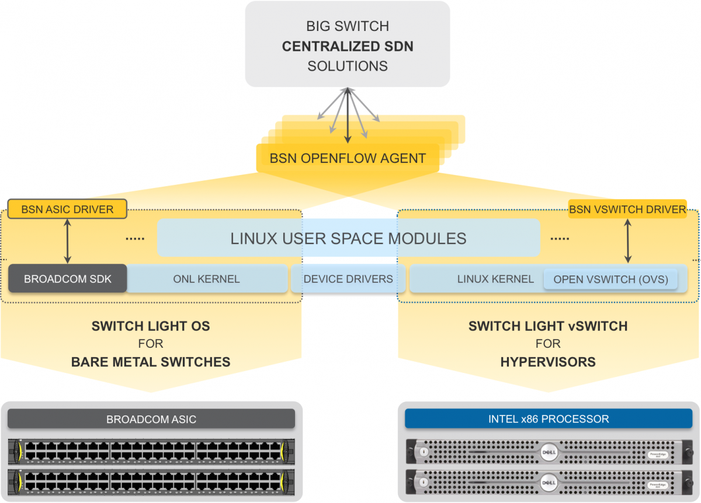
BigSwitch
Controller Type
Modular: Floodlight
Southbound API: OpenFlow
OpenFlow 1.3
SDN Device: Whitebox
(indigo)
SDN Flavor
Underlay+Overlay

Slide 18
SDN EcoSystem
Arista
Broadcom
Cisco
OF + proprietary
OF + proprietary
OF + proprietary
Underlay
Underlay
Underlay+Overlay
Vertical Stack
Vertical Stack
Vertical Stack
HP
Dell
FloodLight
HP
OF
OF
OF
OF
Underlay
Underlay
Underlay+Overlay
Underlay
Vertical Stack
Vertical Stack
Whitebox
Vertical Stack
Juniper
Alcatel
BGP+NetConf
BGP
Overlay
Overlay
Vertical Stack
Vertical Stack

Slide 19
SDN Stack
Applications
Applications
Applications
Controller (Network O.S.)
SDN
Southbound
API
Switch Operating System
Switch Hardware
Southbound API: decouples the switch hardware from control function
Data plane from control plane
Switch Operating System: exposes switch hardware primitives

Slide 20
Section2: Southbound API: OpenFlow

Slide 21

OpenFlow
Developed in Stanford
Standardized by Open Networking Foundation (ONF)
Current Version 1.4
Version implemented by switch vendors: 1.3
Allows control of underlay + overlay
Overlay switches: OpenVSwitch/Indigo-light
PC

Slide 22
How SDN Works: OpenFlow
Applications
Applications
Applications
Controller (N. O.S.)
OpenFlow
OpenFlow
Southbound
API
Switch O.S
Switch O.S
Switch H.W
Switch H.W

Slide 23
OpenFlow: Anatomy of a Flow Table Entry
Match
Action
Counter
Priority
Time-out
When to delete the entry
What order to process the rule
# of Packet/Bytes processed by the rule
Forward packet to zero or more ports
Encapsulate and forward to controller
Send to normal processing pipeline
Modify Fields
Switch
Port
VLAN
ID
VLAN
pcp
MAC
src
MAC
dst
Eth
type
IP
Src
IP
Dst
IP
ToS
IP
Prot
L4
sport
L4
dport

Slide 24
OpenFlow: Types of Messages
Asynchronous (Controller-to-Switch)
Send-packet: to send packet out of a specific port on a switch
Flow-mod: to add/delete/modify flows in the flow table
Asynchronous (initiated by the switch)
Read-state: to collect statistics about flow table, ports and individual flows
Features: sent by controller when a switch connects to find out the features supported by a switch
Configuration: to set and query configuration parameters in the switch
Asynchronous (initiated by the switch)
Packet-in: for all packets that do not have a matching rule, this event is sent to controller
Flow-removed: whenever a flow rule expires, the controller is sent a flow-removed message
Port-status: whenever a port configuration or state changes, a message is sent to controller
Error: error messages
Symmetric (can be sent in either direction without solicitation)
Hello: at connection startup
Echo: to indicate latency, bandwidth or liveliness of a controller-switch connection
Vendor: for extensions (that can be included in later OpenFlow versions)

Slide 25
Dimension of SDN Applications: Rule installation
Proactive Rules
Reactive Rules
Applications
Applications
Applications
Applications
Applications
Applications
Controller (N. O.S.)
Controller (N. O.S.)
O.S
O.S
Switch H.W
Switch H.W

Slide 26
Dimension of SDN Applications: Rule installation
Proactive Rules
Reactive Rules
Controller pre-installs flow table entries
Zero flow setup time
Requires installation of rules for all possible traffic patterns
Requires use of aggregate rules (Wildcards)
Require foreknowledge of traffic patterns
Waste flow table entries
First packet of each flow triggers rule insertion by the controller
Each flow incurs flow setup time
Controller is bottleneck
Efficient use of flow tables

Slide 27
Dimensions of SDN Applications: Granularity of Rules
Microflow
WildCards (aggregated rules)
Applications
Applications
Applications
Applications
Applications
Applications
Controller (N. O.S.)
Controller (N. O.S.)
O.S
O.S
Switch H.W
Switch H.W

Slide 28
Dimensions of SDN Applications: Granularity of Rules
Microflow
WildCards (aggregated rules)
One flow table matches one flow
Uses CAM/hash-table
10-20K per physical switch
Allows precisions
Monitoring: gives counters for individual flows
Access-Control: allow/deny individual flows
One flow table entry matches a group of flow
Uses TCAM
5000~4K per physical switch
Allows scale
Minimizes overhead by grouping flows

Slide 29
Dimensions of SDN Applications: Granularity of Rules
Distributed Controller
Centralized Controller
Applications
Applications
Applications
Applications
Applications
Applications
Controller (N. O.S.)
Controller (N. O.S.)
Applications
Applications
Applications
Applications
Applications
Applications
Switch O.S
Switch HW
Controller (N. O.S.)
Controller (N. O.S.)
Switch O.S
Switch O.S
Switch HW
Switch HW
Switch O.S
Switch HW
Switch O.S
Switch O.S
Switch HW
Switch HW

Slide 30
Google’ B4 Application
Rule installation
Proactive
Rule Granularity
Aggregate
Distributed
Multiple instances

Slide 31
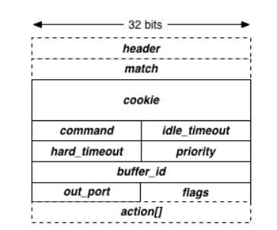
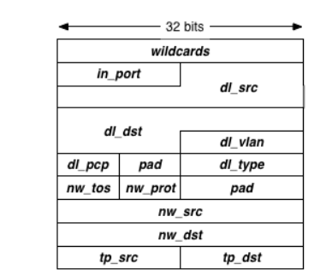
OpenFlow: Message Formats
Controller encapsulates message into an object
Accessor functions to different fields
No need to worry about crafting network packets

Slide 32
OpenFlow Actions (Partial list from OpenFlow 1.0 spec)
Output to switch port (Physical ports & virtual ports). Virtual ports include the following:
ALL (all standard ports excluding the ingress port) - flood
CONTROLLER (encapsulate and send the packet to controller) – PACKET_IN message
LOCAL (switch’s stack) – go through the IP layer, etc (mostly used for vSwitches)
NORMAL (process the packet using traditional non-OpenFlow pipeline of the switch) – traditional L2 forwarding, L3 routing
Drop
Set fields (packet modification/header rewriting)
Ethernet Source address
Ethernet Dest address
IP source & dest addresses, IP ToS, IP ECN, IP TTL, VLAN
TCP/UDP source and destination ports
Strip (pop) the outer VLAN tag
Set queue ID when outputting to a port (Enqueue)
New in OpenFlow 1.1+
Support for matching across mulitple tables
Support for tunneling
Support for Push/Pop mulitple VLAN/MPLS/PBB tags

Slide 33
Conclusion
An overview of SDN technologies
Introduction to OpenFlow

